Slide 1
The Importance of Customer Service
Notes:
Hi! I’m Sonya, and Today we are at the flower shop to talk about The Importance of Customer Service.

Slide 2
Notes:
We know that our business is designing and selling beautiful floral arrangements for every occasion, but our service needs a refresh.

Slide 3
Notes:
There is nothing worse than an angry customer. You know the ones I mean- the flowers were wrong, the service was rude, I want a refund.

Slide 4
77%
50%
80%
Notes:
According to the Netomi Pulse Report, 77% of respondents say customer service is critical to getting repeat customers.
And, according to Zendesk, 50% of customer switch brands/companies after a bad experience and 80% switch after 2 bad experiences.
Through research, we have found that poor service is to blame, but there are some simple fixes we can start immediately.

Slide 5
//////////
Notes:
But, with improvements in our customer service can go a long way towards deescalating that anger and frustration, and lead happier customers, better sales and brand loyalty.

Slide 6
Greeting
Showing interest in their needs
Being available
Showing gratitude for their patronage.
Notes:
How are we going to do this? With a few simple tasks: greeting, showing interest in customer needs, being available for customers, and communicating our gratitude for their patronage.

Slide 7
+
=
Notes:
Great Flowers plus great customer service equals brand loyalty!

Slide 8
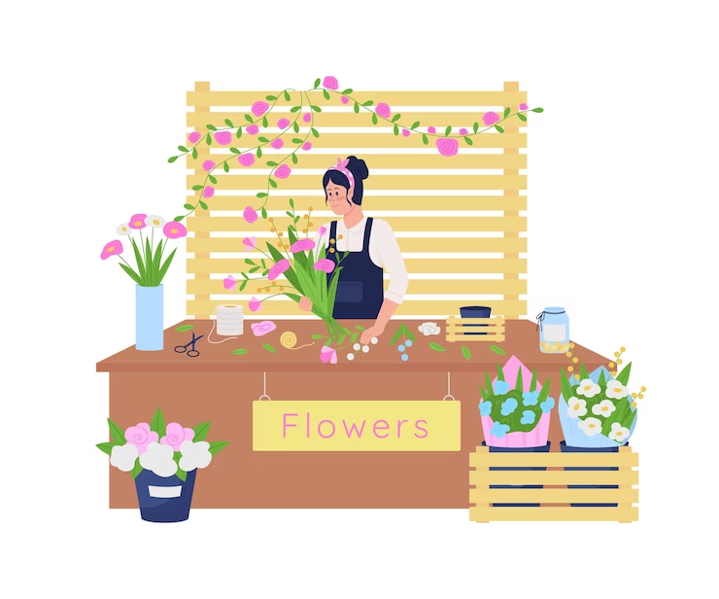
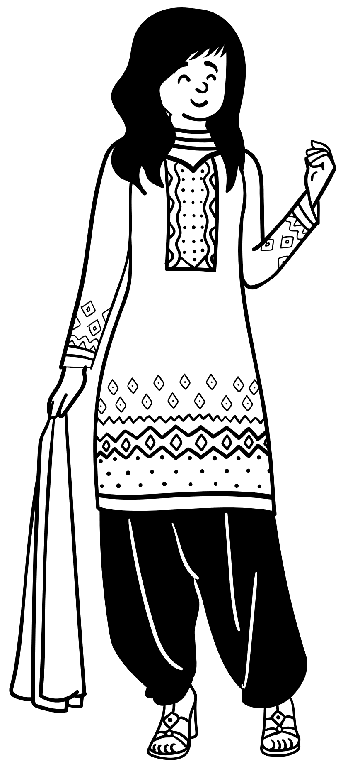
Hello! Welcome to Silver Fox!
Notes:
So, task 1: the Greeting
Make sure you are greeting every customer who comes through our doors. A simple, “Hello, Welcome in” or “Welcome to Silver Fox” goes a long way towards helping customers feel seen.

Slide 9
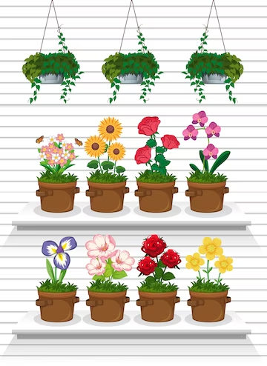
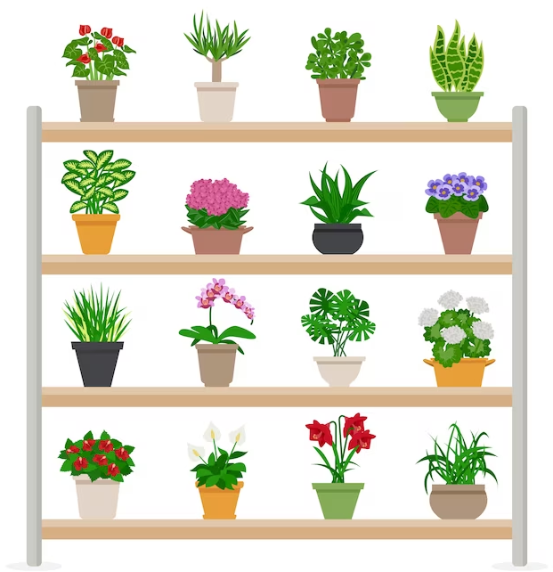
Be available.
How can I help you today?
Notes:
Task 2: Be available.
We all have designs to do, calls to answer, and vases to deliver, but the customer in our shop must be the priority. This is the perfect time for gaining a customer for life. So, drop what you are doing, and approach the customer. Ask them questions and make suggestions for how to fulfill their needs.

Slide 10
The Tone of Your Voice Matters
Show interest in their Needs
Ask Questions
Smile
Notes:
Task 3: Tone of voice matters
It’s not just the words we say, it’s how we say it. Have a bit of enthusiasm. Show you are interested in the customer’s needs. It goes a long way towards helping customers feel valued.

Slide 11
Thank you for coming in.
Notes:
The final task is the thank you. At the end of every customer interaction, whether there is a sale or not, thank the customer for coming in. We appreciate their patronage and their time. Perhaps they will purchase the next time they are in, but if we are rude to them or uninterested in helping them fulfill their needs, we will lose that opportunity.

Slide 12
Notes:
With a few simple changes, we can improve our customer service, thereby increasing sales, and brand loyalty.

Slide 13
A great place to bloom!
Notes:
Thank you for being with us at Silver Fox Florist- A great place to bloom!

